Slide 1

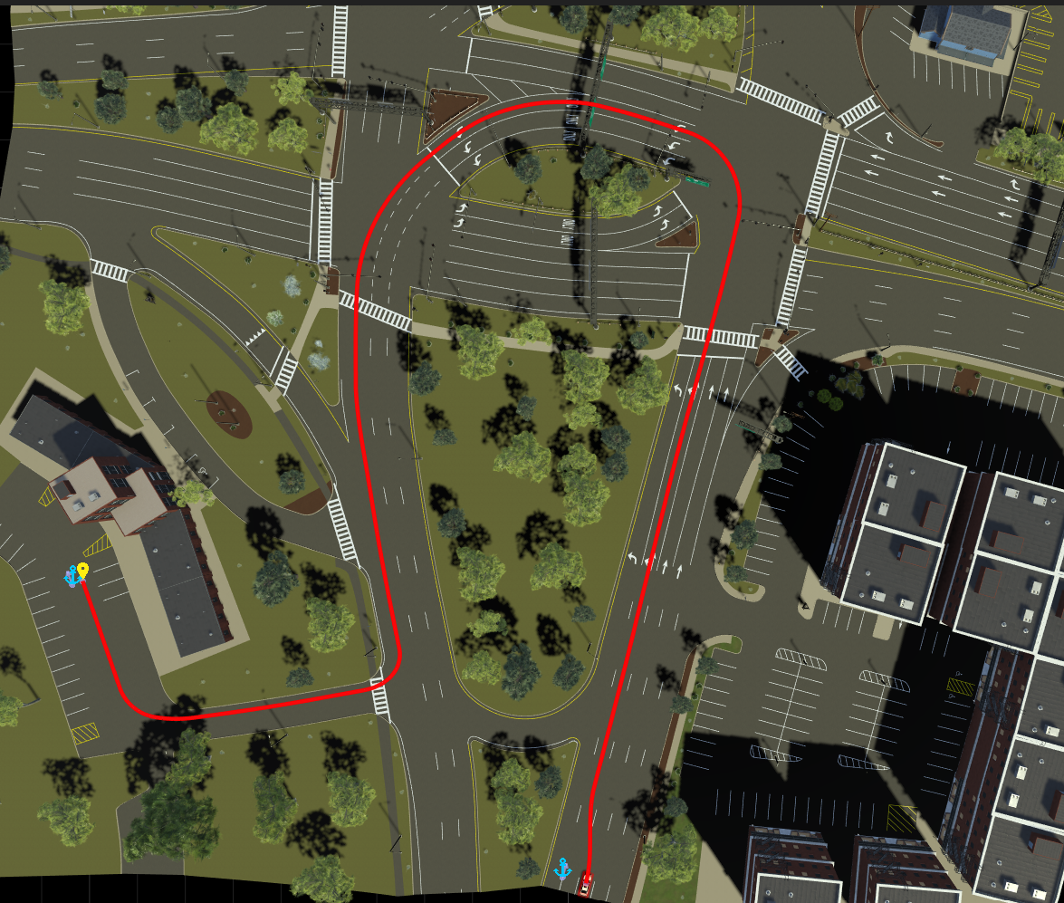
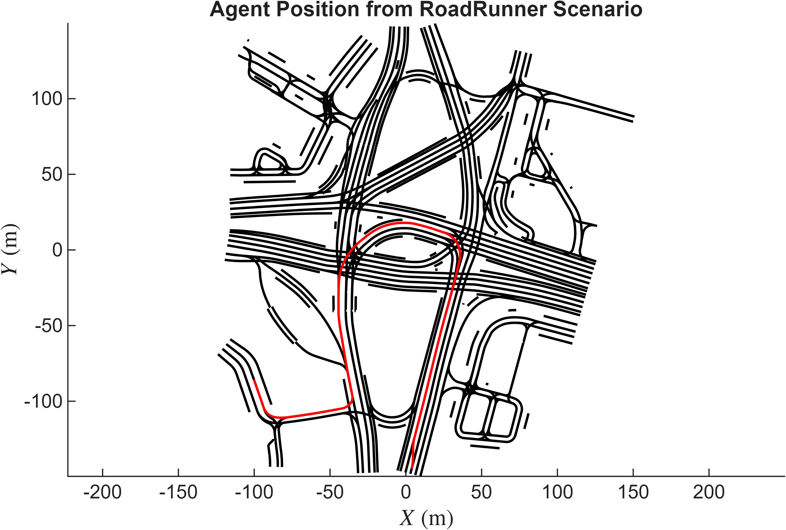
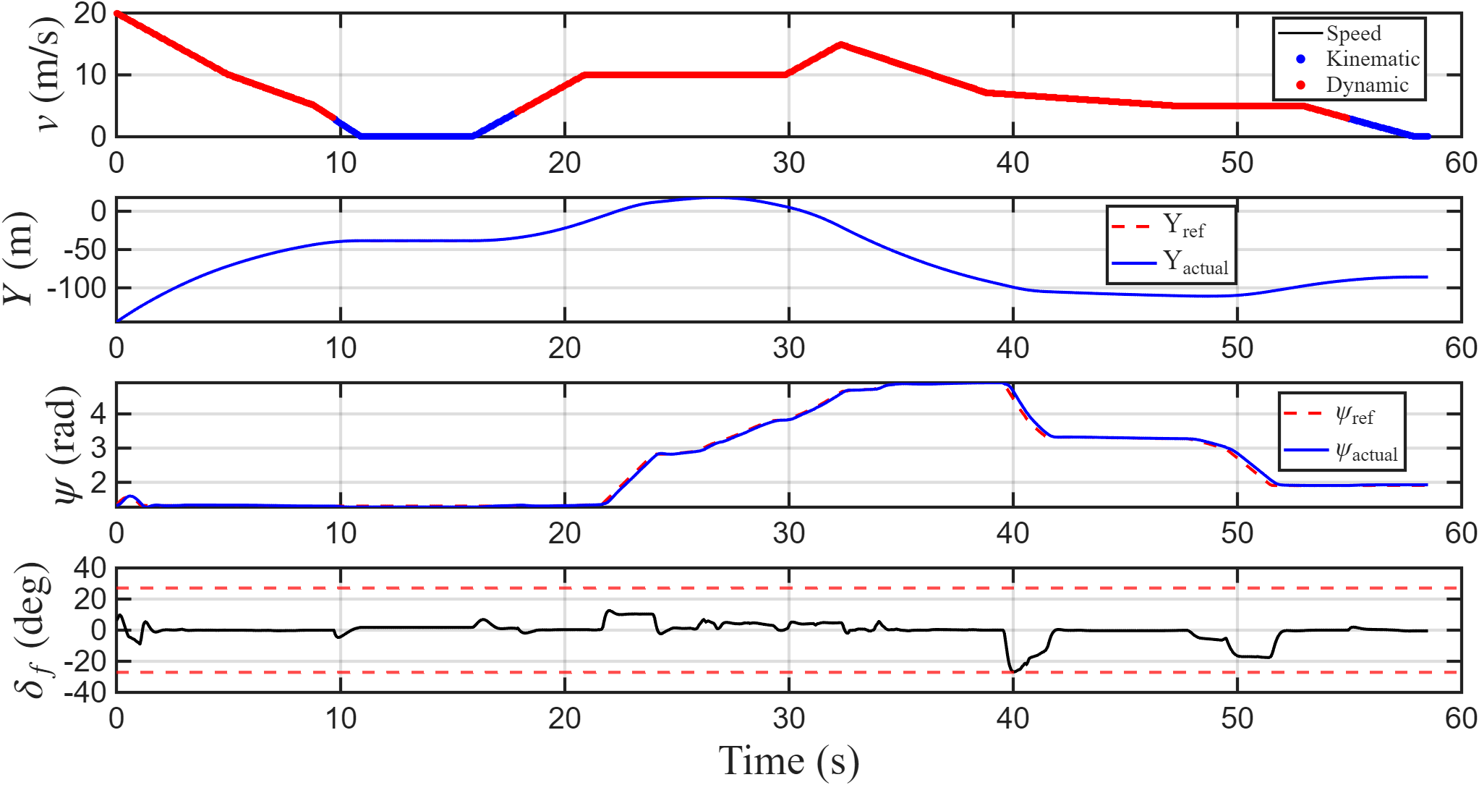
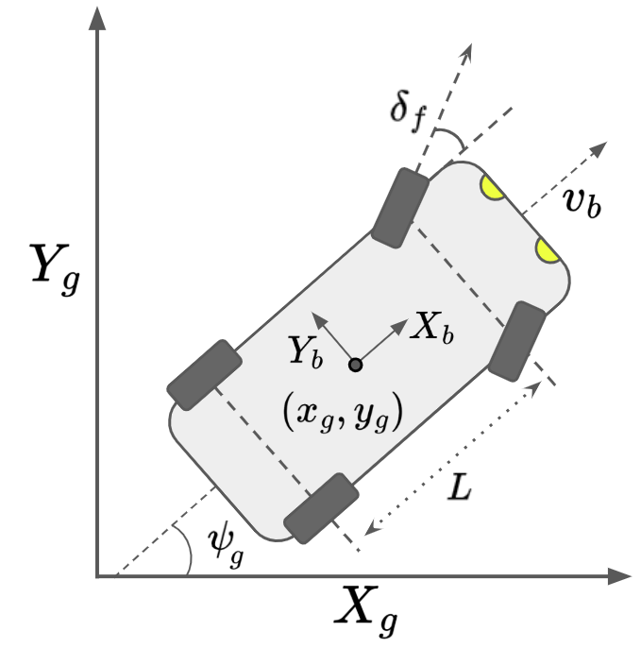
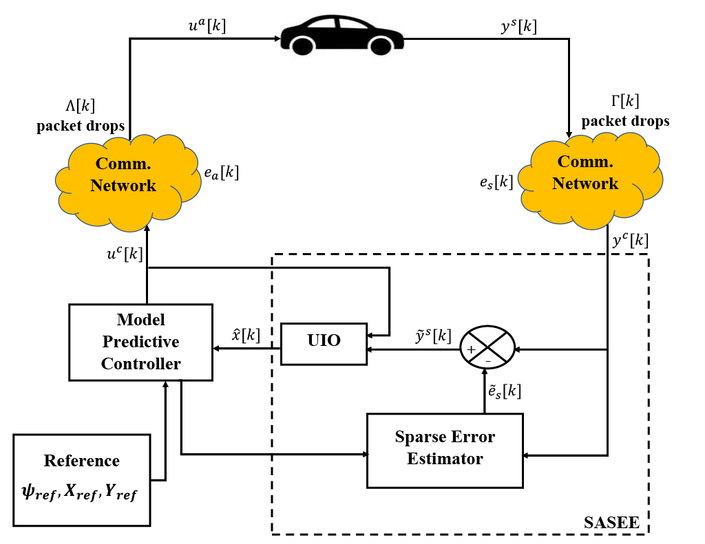
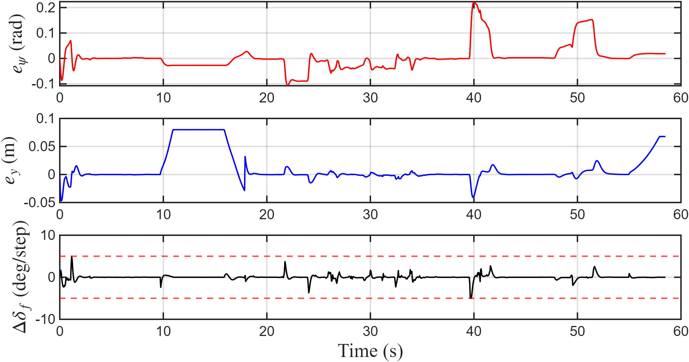
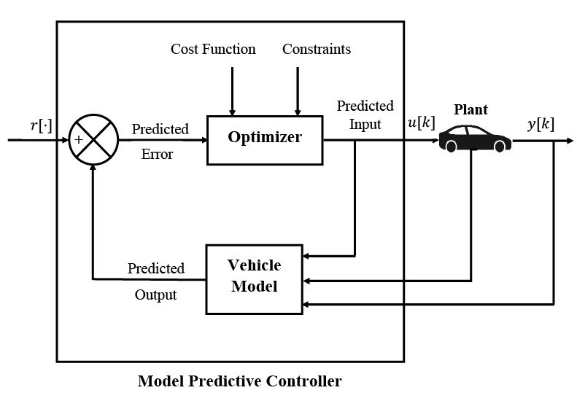
Autonomous Vehicle Modeling and Trajectory Tracking in the Presence of Malicious Packet Drops
12th Midwest Workshop on Control and Game Theory
Somtochukwu M. Oguchienti, Yousif H. Alhajji, David R. Nelson, Joey H. Sun, Stanislaw H. Żak
Abstract
A combined state and sparse error estimator-model predictive controller (SASEE-MPC) is proposed for autonomous vehicle trajectory tracking in the presence of malicious packet drops. The vehicle motion is modeled using a combination of kinematic and dynamic models to more accurately describe the vehicle motion for low and high velocities. MATLAB RoadRunner simulations demonstrate the effectiveness of the proposed control scheme.
Simulation
Problem Statement
Proposed Solution
Propose a model for autonomous vehicle trajectory tracking for low and high speeds
Design a resilient controller for autonomous vehicle trajectory tracking in the presence of malicious attacks
For low speed vehicle motion, we use the kinematic vehicle model
We use dynamic vehicle model for high speed vehicle motion
We design a hybrid model predictive controller that combines both models based on varying longitudinal vehicle speeds
We model malicious attacks as packet drops through the communication network
We propose an estimator for the malicious packet drops
We design an unknown input observer to estimate the vehicle state
We design a combined State and Sparse Error Estimator-Model Predictive Controller (SASEE-MPC) Compensator
Conclusion
Demonstrated that our vehicle model is able to accurately track a given reference trajectory at low and high speeds
Demonstrated the effectiveness of our observer-controller compensator to estimate the vehicle state and sparse malicious packet drops

